Slide 1

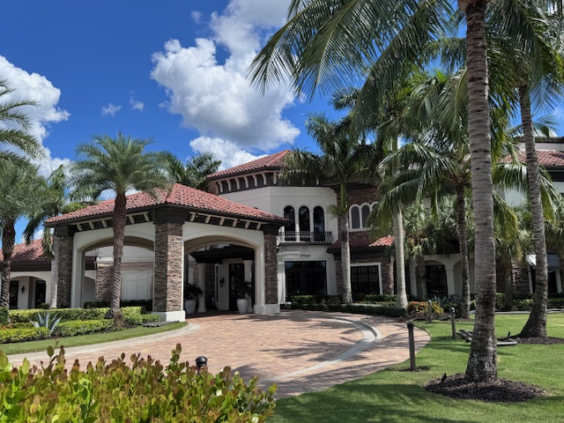
Golf Club Monthly Board of Directors Meeting
March 24, 2026

Slide 2
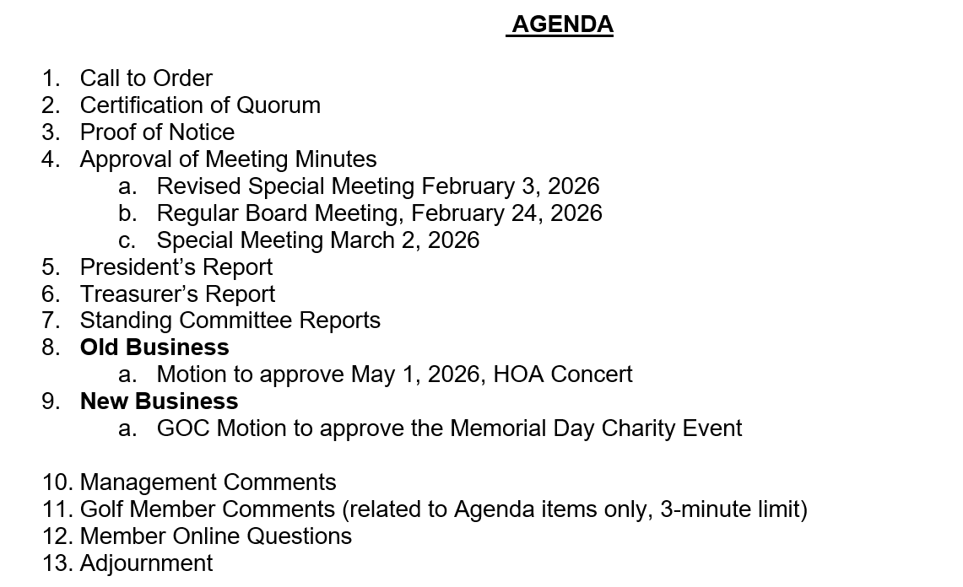

Slide 3


Slide 4


Slide 5
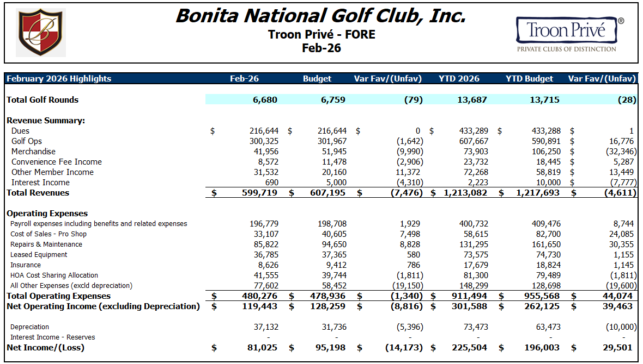

Slide 6

Committee Reports

Slide 7

Bonita National Golf Club, Inc
Old Business
Motion to approve May 1, 2026, HOA Concert

Slide 8
Bonita National Golf Club, Inc
New Business
  GOC Motion to approve the Memorial Day Charity Event

Slide 9
Management Comments

Slide 10

Member Comments
Online Questions?

Slide 11

Adjournment
Next board meeting
April 28, 2026 @ 4:00pm

